Slide 1
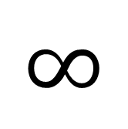
$$∞$$
Black White
I

Slide 2



Urn 1
Urn 2
1
flip
and
draw
Draws
Draws
Draws
{heads, black}
{heads, black}
{heads, black}
{heads, white}
{heads, white}
{tails, black}

Slide 3
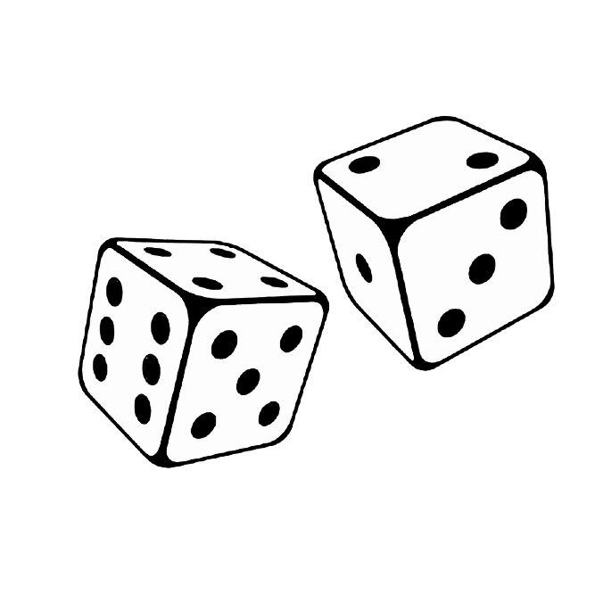
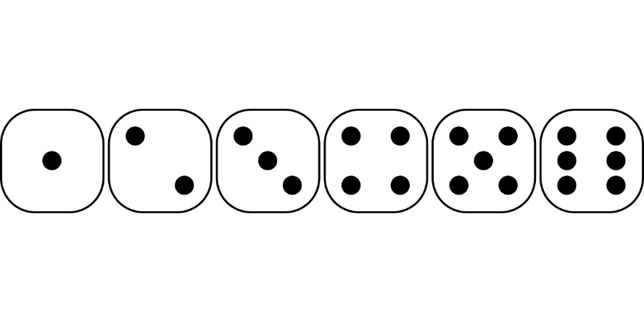
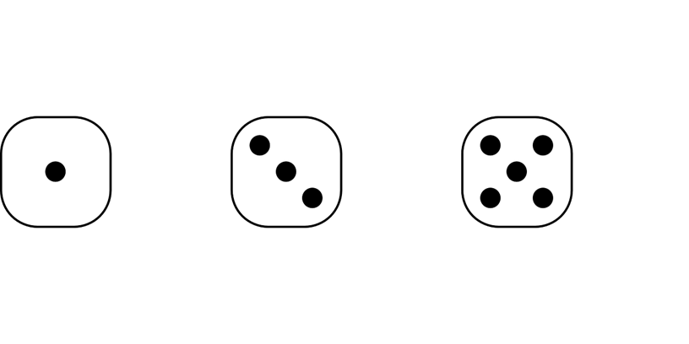
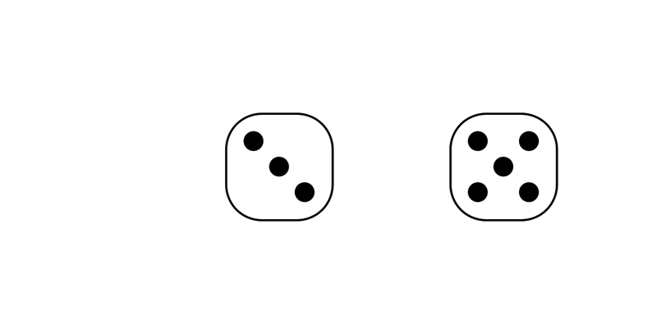
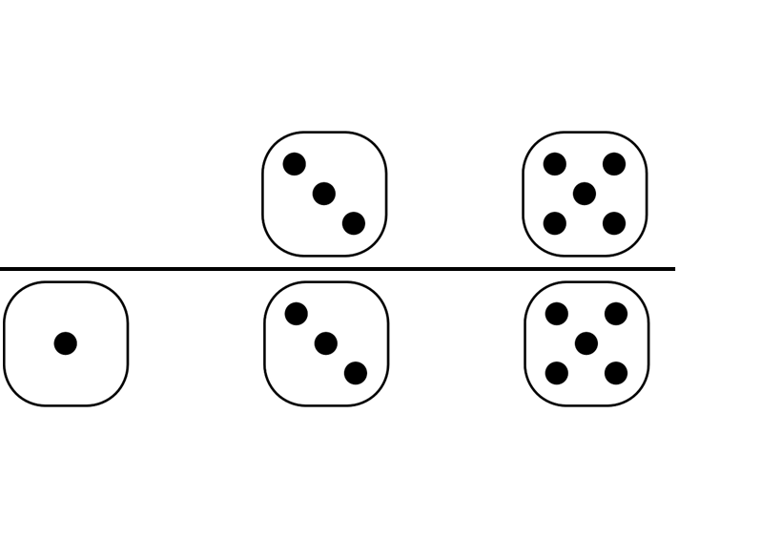
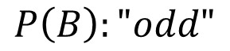
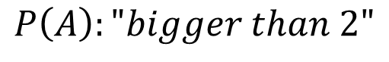
$$P\left(A\right):"bigger than 2"$$
= 2/3
$$P\left(B\right):"odd"$$
= 1/2
$$P\left(A∩B\right):"bigger than 2" and "odd"$$
= 1/3
$$P\left(A|B\right):"bigger than 2" given "odd"$$
= 2/3

Slide 4
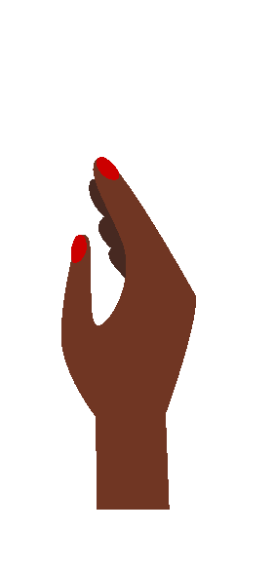
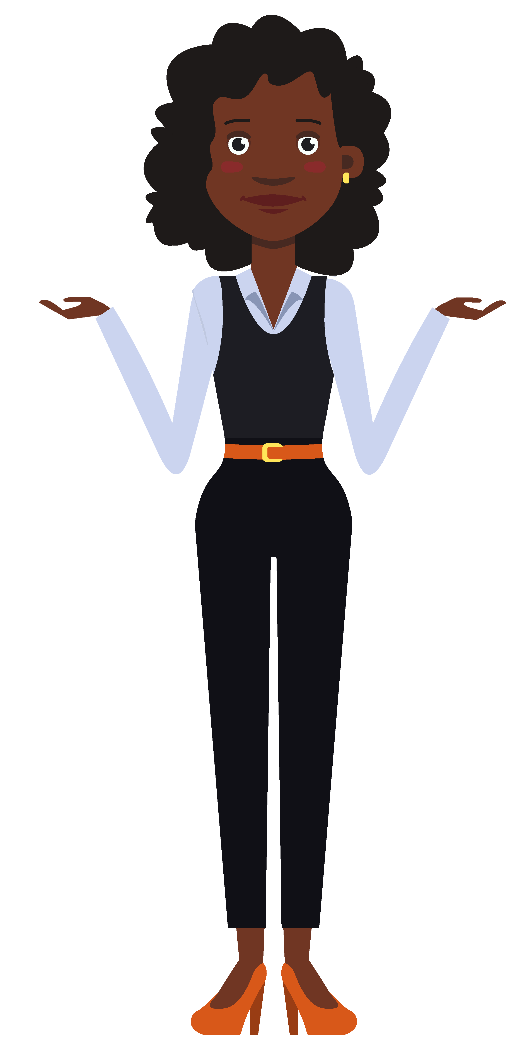
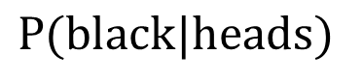
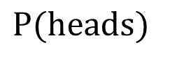
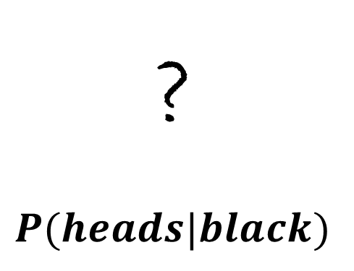
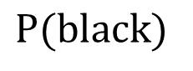
$$P(black|heads)$$
$$P(black)$$
Urn 1
Urn 2
?
$$P(heads|black)$$
Jones
$$P(heads)$$
"Designed by Katemangostar / Freepik“

Slide 5
License:
Free for personal and commercial purpose with attribution.
Attribution:
"Designed by Katemangostar / Freepik“ !
Source:
https://www.freepik.com/free-vector/flat-icons-set-black-business-woman-views-poses-emotions_3296534.htm#page=13&query=set+black+woman&position=13

Slide 6
License:
Free for personal and commercial purpose with attribution.
Attribution:
"Designed by Katemangostar / Freepik“ !
Source:
https://www.freepik.com/free-vector/flat-icons-set-black-lady_3296535.htm#page=6&query=set+black+woman&position=15

Slide 7
License:
Free for personal and commercial purpose with attribution.
Attribution:
"Designed by Katemangostar / Freepik“ !
Source:
https://www.freepik.com/free-vector/flat-icons-set-indian-woman-views-poses-emotions_3296541.htm#page=22&query=set+black+woman&position=44

Slide 8
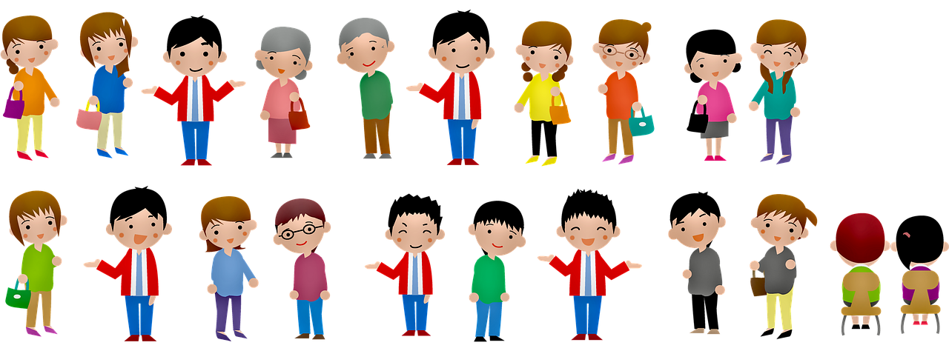
Source: https://pixabay.com/de/illustrations/menschen-mann-frauen-oma-opa-4035403/
License: Freie kommerzielle Nutzung; Kein Bildnachweis nötig

